Slide 1

BS – 101 Engineering Physics
Lecture – 17
Engr. Safee Ullah

Slide 2
Diode Limiters
Figure shows a diode positive limiter (also called clipper) that limits
or clips the positive part of the input voltage.
As the input voltage goes positive, the diode becomes forward biased and conducts current.
Point A is limited to +0.7 V when the input voltage exceeds this value.
When the input voltage goes back below 0.7 V, the diode is reverse-
biased and appears as an open.
The output voltage looks like the negative part of the input voltage, but with a magnitude determined by the voltage divider formed by
𝑅₁ and the load resistor, 𝑅_{𝐿}, as follows:
𝑅_{𝐿}
^{𝑉}𝑜𝑢𝑡 ⁼
𝑉
𝑖𝑛
𝑅₁ + 𝑅_{𝐿}

Slide 3
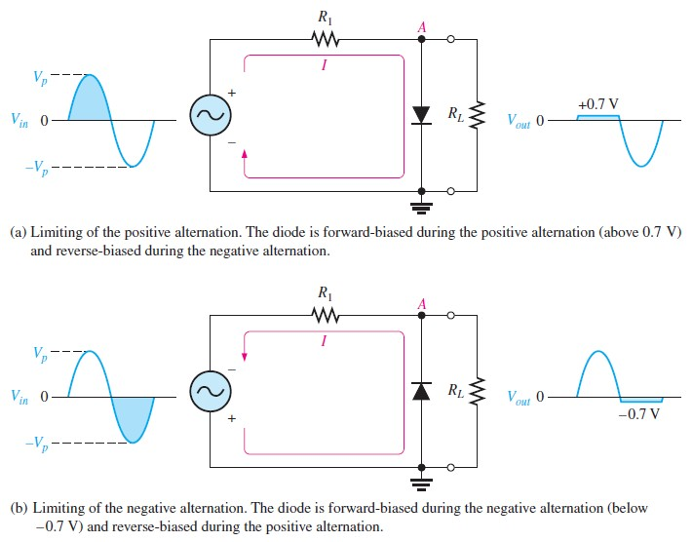
Diode Limiters (Contd.)

Slide 4
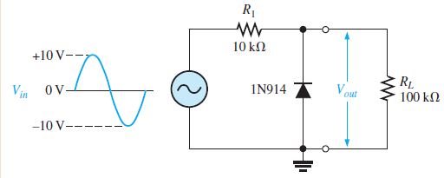
Diode Limiters (Example)
What would you expect to see displayed on an oscilloscope connected across 𝑅_{𝐿} in the limiter shown in Figure.

Slide 5
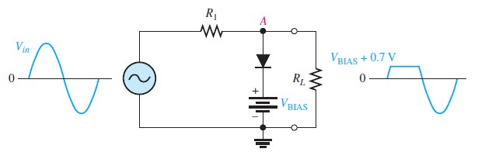
Biased Limiters
The level to which an ac voltage is limited can be adjusted by adding a bias voltage, 𝑉_{𝐵𝐼𝐴𝑆}, in series with the diode, as shown in Figure. The voltage at point A must equal 𝑉_{𝐵𝐼𝐴𝑆} + 0.7 𝑉 before the diode will become forward-biased and conduct. Once the diode begins to conduct, the voltage at point A is limited to
𝑉_{𝐵𝐼𝐴𝑆} + 0.7 𝑉 so that all input voltage above this level is clipped off.

Slide 6
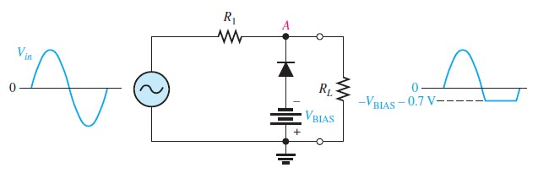
Biased Limiters (Contd.)
To limit a voltage to a specified negative level, the diode and bias voltage must be connected as in Figure. In this case, the voltage at point A must go below −𝑉_{𝐵𝐼𝐴𝑆} − 0.7 𝑉 to forward- bias the diode and initiate limiting action as shown.

Slide 7
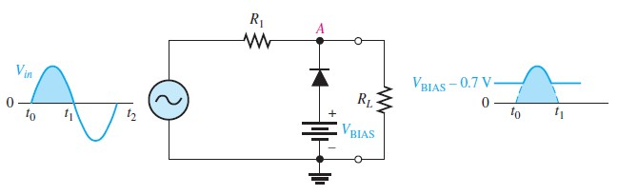
Biased Limiters (Contd.)
By turning the diode around, the positive limiter can be modified to limit the output voltage to the portion of the input voltage waveform above as shown by the output waveform in Figure.

Slide 8
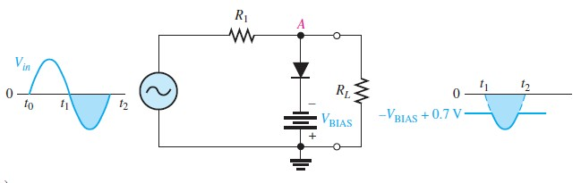
Biased Limiters (Contd.)
Similarly, the negative limiter can be modified to limit the output voltage to the portion of the input voltage waveform below −𝑉_{𝐵𝐼𝐴𝑆} +
0.7 𝑉 , as shown by the output waveform in Figure.

Slide 9
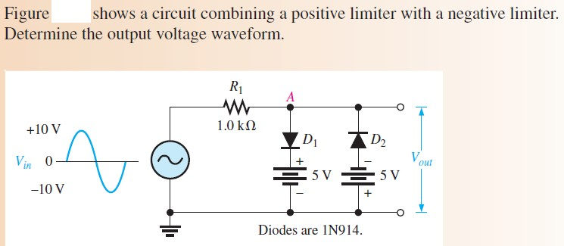
Biased Limiters (Example)

Slide 10
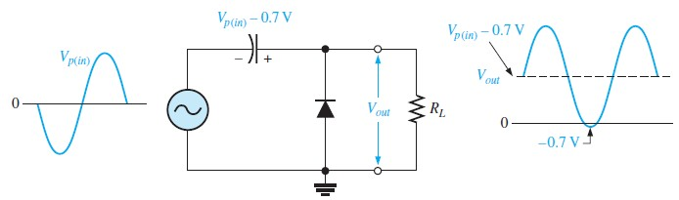
Diode Clampers
A clamper adds a dc level to an ac voltage. Clampers are sometimes known as dc restorers. Figure shows a diode clamper that inserts a positive dc level in the output waveform.

Slide 11
Diode Clampers
A clamper adds a dc level to an ac voltage. Clampers are sometimes known as dc restorers. Figure shows a diode clamper that inserts a positive dc level in the output waveform.

Slide 12
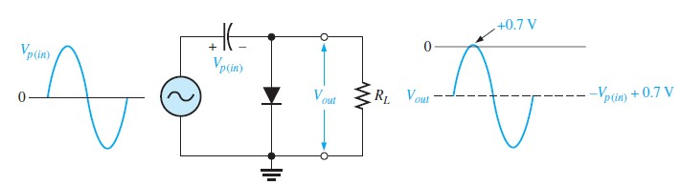
Diode Clampers (Contd.)

Slide 13
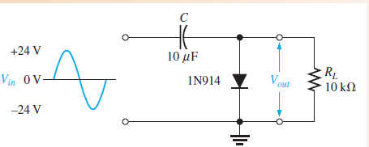
Diode Clampers (Example)
What is the output voltage that you would expect to observe across 𝑅_{𝐿} in the clamping circuit? Assume that 𝑅𝐶 is large enough to prevent significant capacitor discharge.

